Slide 1
Attendance & Re-engagement
Improved Accessibility, Enhanced Comprehension, Reinforced Learning, Increased Engagement, Making our students & families feel valued in our district.

Slide 2
Attendance, Chronic Absenteeism, and Truancy
Attendance is a critical building block for student learning. If students are not present, they cannot engage in learning. Attendance is a powerful signal and leading indicator of equity. It can signal when students might need additional support and areas for system and school improvement. Chronic absenteeism impacts all students—no matter their age. Students that miss just two days a month for any reason are more likely to not read at grade level, and more likely to not graduate.

Slide 3
Root Causes for Absences
Chronic absenteeism is a signal to educators and parents that a student may be experiencing barriers to attending or engaging in school. These underlying barriers or root causes must be understood to effectively support the student and family to attend and engage.
The root cause of student absences can come from one or several of these contexts:
School (e.g. school environment does not feel welcoming)
Classroom (e.g. curriculum does not feel relevant)
Community (e.g. unsafe walking routes)
Family (e.g. unreliable transportation)
Student (e.g. motivation, anxiety)
Woodland Public School believes that educators have a great opportunity to get curious about why students aren’t attending, to provide effective and tailored interventions that address our students specific root cause for not attending.

Slide 4
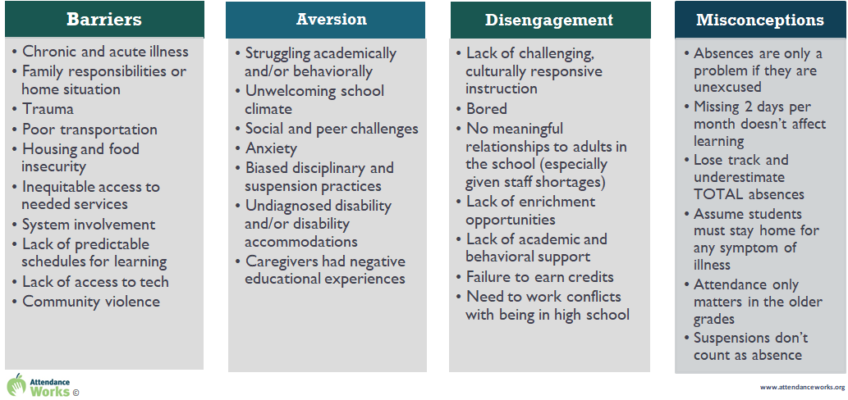
Understanding the root causes for student absenteeism
When identifying root causes for absenteeism for the students in our classrooms or schools, consider the positive conditions for learning and which of those conditions are missing for the student(s) who are chronically absent.

Slide 5
Our Goal
To foster Student Engagement by assisting in removing barriers that prevent our students from attending regularly.
By building healthy relationships, creating a lively, motivating, and inclusive learning environment where students feel valued, supported, and empowered to participate actively to achieve their personal academic goals for their future.
We want to provide a sense of belonging that ensures all of our students feel welcome and accepted regardless of their background and/or abilities.

Slide 6
Student Success Story

Slide 7
Thank You!

